Slide 1
Isolation Forest for Anomaly Detection
Utsha Das
Roll: 2004103020
Department of Computer Science and Engineering
Rajshahi University of Engineering & Technology

Slide 2
Table of Contents
Outlier
Anomaly Detection
Methods for Anomaly Detection
Isolation Forest
Random Forest vs Isolation Forest
Isolation Forest Algorithm
Isolation Forest using SK-Learn
Application

Slide 3
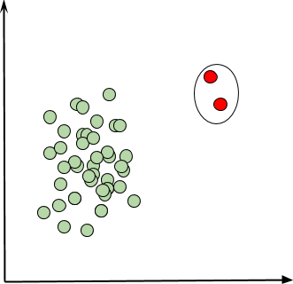
Outlier
An outlier is nothing but a data point that differs significantly from other data points in the given dataset.

Slide 4
Anomaly Detection
Anomaly detection is the process of finding the outliers in the data
Why Anomaly Detection?
Banking
Finance
Healthcare
Manufacturing
Networking
Notes:
Large, real-world datasets may have very complicated patterns that are difficult to detect by just looking at the data. That's why the study of anomaly detection is an extremely important application of Machine Learning.
Banking. Finding abnormally high deposits. Every account holder generally has certain patterns of depositing money into their account. If there is an outlier to this pattern the bank needs to be able to detect and analyze it, e.g. for money laundering.
Finance. Finding the pattern of fraudulent purchases. Every person generally has certain patterns of purchases which they make. If there is an outlier to this pattern the bank needs to detect it in order to analyze it for potential fraud.
Healthcare. Detecting fraudulent insurance claims and payments.
Manufacturing. Abnormal machine behavior can be monitored for cost control. Many companies continuously monitor the input and output parameters of the machines they own. It is a well-known fact that before failure a machine shows abnormal behaviors in terms of these input or output parameters. A machine needs to be constantly monitored for anomalous behavior from the perspective of preventive maintenance.
Networking. Detecting intrusion into networks. Any network exposed to the outside world faces this threat. Intrusions can be detected early on using monitoring for anomalous activity in the network.

Slide 5
Methods for Anomaly Detection
Statistical (Z-score, Tukey's range test and Grubbs's test)
Density-based techniques (k-nearest neighbor, local outlier factor, isolation forest, etc)
One-class support vector machines
Replicator neural networks, autoencoders, variational autoencoders,long short-term memory neural networks
Bayesian networks
Hidden Markov models (HMMs)
Minimum Covariance Determinant
Clustering: Cluster analysis-based outlier detection
Fuzzy logic-based outlier detection

Slide 6
Isolation Forest
Isolation forest is a machine learning algorithm for anomaly detection.
It's an unsupervised learning algorithm that identifies anomaly by isolating outliers in the data.
Isolation Forest is based on the Decision Tree algorithm. It isolates the outliers by randomly selecting a feature from the given set of features and then randomly selecting a split value between the max and min values of that feature.
This random partitioning of features will produce shorter paths in trees for the anomalous data points, thus distinguishing them from the rest of the data.

Slide 7
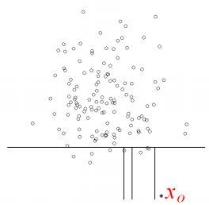
Random Forest vs Isolation Forest
Random Forest are bunch of decision tress. In classification, DT keeps partitioning the data, one feature at a time, until each partition is homogeneous.
Isolation Forest involve building isolation trees. The idea is to make partitions such that each data point is isolated, not homogeneous. Particular partition contains only that data point.

Slide 8
Isolation Forest Algorithm
Approach:
Repeat
Randomly Sample a subset of Data
Build a tree from random sample
Each tree is generated by randomly choosing a splitting attribute and the split point
The tree is grown either until the maxdepth is reached, only one point remains, or all attributes have the same values.
Outliers are easier to be isolated. They tend to reside at shallower depthof the tree.
Notes:
Anomaly Score S(x,m) = 2^(-E(h(x))/c(m)). M= sample size, E= expected. h(x)= average search heights for x from I tress. C(m) =average value of h(x).

Slide 9
Isolation Forest using sklearn
class sklearn.ensemble.IsolationForest(n_estimators, max_samples, contamination, max_feature)
Number of estimators: n_estimators refers to the number of base estimators or trees in the ensemble, i.e. the number of trees that will get built in the forest. This is an integer parameter and is optional. The default value is 100.
Max samples: max_samples is the number of samples to be drawn to train each base estimator. If max_samples is more than the number of samples provided, all samples will be used for all trees. The default value of max_samples is 'auto'. If 'auto', then max_samples=min(256, n_samples)

Slide 10
Isolation Forest using sklearn (Cont.)
Contamination: This is a parameter that the algorithm is quite sensitive to; it refers to the expected proportion of outliers in the data set. This is used when fitting to define the threshold on the scores of the samples. The default value is 'auto'. If ‘auto’, the threshold value will be determined as in the original paper of Isolation Forest.
Max features: All the base estimators are not trained with all the features available in the dataset. It is the number of features to draw from the total features to train each base estimator or tree. The default value of max features is one.

Slide 11
Isolation Forest using sklearn (Cont.)
Contamination: This is a parameter that the algorithm is quite sensitive to; it refers to the expected proportion of outliers in the data set. This is used when fitting to define the threshold on the scores of the samples. The default value is 'auto'. If ‘auto’, the threshold value will be determined as in the original paper of Isolation Forest.
Max features: All the base estimators are not trained with all the features available in the dataset. It is the number of features to draw from the total features to train each base estimator or tree. The default value of max features is one.

Slide 12
Isolation Forest using sklearn (Cont.)
import numpy as np
import pandas as pd
import seaborn as sns
import matplotlib.pyplot as plt
import matplotlib.gridspec as gridspec
from sklearn.ensemble import IsolationForest
df=pd.read_csv('E:/MSc/MSc Thesis/Thesis/DiabetesData/Diabetes.csv')

Slide 13
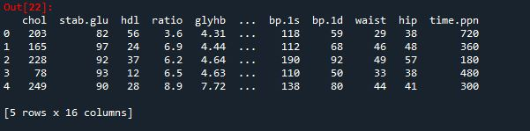
Isolation Forest using sklearn (Cont.)
df.head()

Slide 14
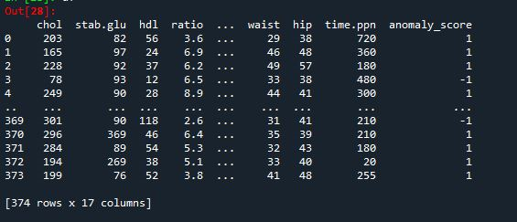
Isolation Forest using sklearn (Cont.)
clf = IsolationForest(n_estimators=100,max_samples='auto',contamination=.05,max_features=1.0)
clf.fit(x)
df['anomaly_score'] = clf.predict(df)

Slide 15
Application
Sample: 374
Model | Acc | Sen | Spe | MCC | F1 | AUC
KNN(k=5) | 0.88 | 0.33 | 0.98 | 0.46 | 0.47 | 0.66
LR | 0.96 | 0.75 | 1 | 0.85 | 0.86 | 0.875
NB | 0.97 | 1 | 0.97 | 0.91 | 0.92 | 0.98
NN | 0.986 | 0.889 | 1.0 | 0.935 | 0.941 | 0.944
SVM | 0.962 | 0.7625 | 1 | 0.854 | 0.86494 | 0.88125

Slide 16
Application
Sample: 355
Model | Acc | Sen | Spe | MCC | F1 | AUC
KNN(k=5) | 0.90 | 0.22 | 1 | 0.44 | 0.37 | 0.61
LR | 0.986 | 0.88 | 1 | 0.935 | 0.941 | 0.944
NB | 0.972 | 1 | 0.97 | 0.89 | 0.9 | 0.984
NN | 0.95 | 0.75 | 0.98 | 0.79 | 0.81 | 0.87
SVM | 0.97817 | 0.85 | 0.99677 | 0.89826 | 0.90728 | 0.92339

Slide 17
Thank You

